Slide 1
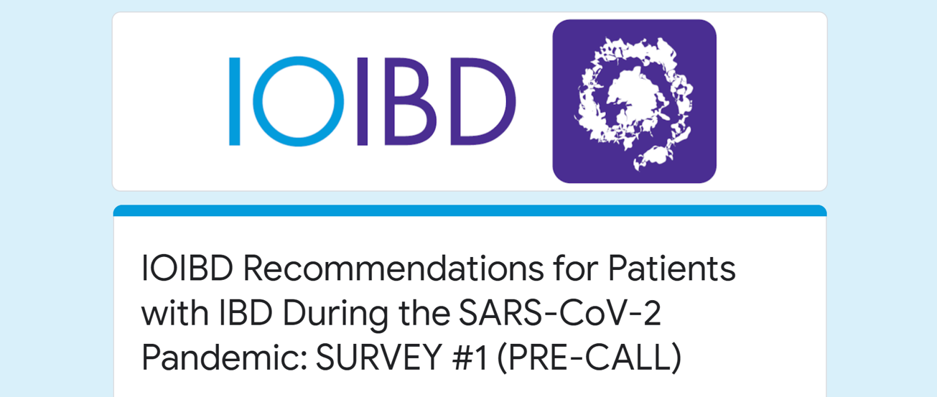

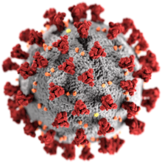
COVID-19 Webinar
20 March 2020

Slide 2

SARS-Cov2 and the potential impact for patients on non-biologics
Maria T. Abreu, MD
Director, Crohn’s and Colitis Center
Professor of Medicine,
Microbiology and Immunology
University of Miami Miller School of Medicine
Miami, Florida

Slide 3
Acknowledgements
    Corey Siegel
    David Rubin
    Marischka Konings
    Oriana Damas

Slide 4
Approach to the topic
Do IBD medications increase risk of infection with SARS-CoV-2?
Do IBD medications increase risk of COVID-19 disease and/or its severity?
How long does immunological effect of these medicines last when stopped?
Medications to cover:
  Mesalamines
  Steroids, including budesonide
  Thiopurines
  Methotrexate
  JAK inhibitors

Slide 5
Viral transmission
Hoffmann et al., 2020, Cell 181, 1–10
Notes:
This transmission electron microscope image shows SARS-CoV-2—also known as 2019-nCoV, the virus that causes COVID-19—isolated from a patient in the U.S. Virus particles are shown emerging from the surface of cells cultured in the lab. The spikes on the outer edge of the virus particles give coronaviruses their name, crown-like.

Slide 6
Virus enters nose, mouth, eyes and attaches to cells in the airway that produce ACE2 receptor.
ACE2 receptor found in multiple organs including the GI tract.
Virus has been found in stool even after respiratory clearance
Move to screen in FMTs
GI symptoms in some patients affected by COVID-19
Anecdotally, ACE2 on T cells in periphery and lamina propria and on CD11b cells in lamina propria
Ianiro Lancet gastroenterology and hep; DOI:https://doi.org/10.1016/S2468-1253(20)30082-0

Slide 7
ACE2 expressed in GI tract and virus has been found in epithelial cells
Xiao Gastroenterology. 2020; (published online March 3.)DOI:10.1053/j.gastro.2020.02.055
Notes:
Importantly, viral host receptor ACE2 stained positive mainly in the cytoplasm of gastrointestinal epithelial cells (Figure 1). To note, we observed that ACE2 is rarely expressed in esophageal epithelium, but abundantly distributed in cilia of glandular epithelia. Staining of viral nucleocapsid protein (NP) was visualized in the cytoplasm of gastric,duodenal and rectum glandular epithelial cell,but not in esophageal epithelium. The positive staining of ACE2 and SARS-CoV-2 was also observed in gastrointestinal epithelium from other patients, who tested positive for SARS-CoV-2 RNA in feces (data not shown).

Slide 8
Virus Infection and inflammatory cytokines induce ACE2 upregulation
Expression level of ACE2 is extremely important for the successful infection of SARS-nCoV and 2019-nCoV
Organs and tissues with high ACE2 abundance like the lung, kidney and small intestine are the infection targets of 2019-nCoV (Zhang et al., 2020).
ACE2 can be significantly upregulated after infection of various viruses including SARS-CoV and MERS-CoV
ACE2 can be significantly induced by IFN-gamma treatment in human primary keratinocytes
Promoter region of ACE2 exists several immune- and cytokine-responsive transcript factor binding sites such as JUN
Zhang H, et al (2020). The digestive system is a potential route of 2019-nCov infection: a bioinformatics analysis based on single-cell transcriptomes. bioRxiv.
BioRxiv doi: https://doi.org/10.1101/2020.02.24.963348

Slide 9
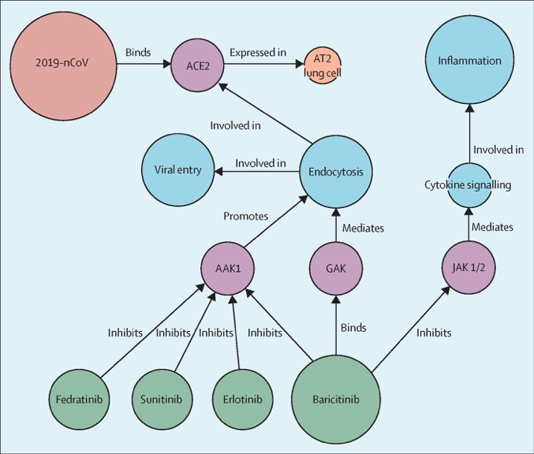

Certain JAK inhibitors may prevent endocytosis of the virus
The Lancet 2020 395, e30-e31DOI: (10.1016/S0140-6736(20)30304-4)
Copyright © 2020 Elsevier Ltd Terms and Conditions
Notes:
The BenevolentAI knowledge graph
The BenevolentAI knowledge graph integrates biomedical data from structured and unstructured sources. It is queried by a fleet of algorithms to identify new relationships to suggest new ways of tackling disease. 2019-nCoV=2019 novel coronavirus. AAK1=AP-2 associated kinase 1. GAK=cyclin g-associated kinase. JAK1/2=janus kinase 1/2.

Slide 10
No specific information on mesalamines
Concern about NSAIDs debunked

Slide 11
Clinical evidence does not support corticosteroid treatment for 2019-nCoV lung injury
Russell, CD, et al Lancet. 2020 Feb 15;395(10223):473-475. doi: 10.1016/S0140-6736(20)30317-2. Epub 2020 Feb 7.
Notes:
In a retrospective observational study reporting on 309 adults who were critically ill with MERS,2 almost half of patients (151 [49%]) were given corticosteroids (median hydrocortisone equivalent dose [ie, methylprednisolone 1:5, dexamethasone 1:25, prednisolone 1:4] of 300 mg/day). Patients who were given corticosteroids were more likely to require mechanical ventilation, vasopressors, and renal replacement therapy. After statistical adjustment for immortal time and indication biases, the authors concluded that administration of corticosteroids was not associated with a difference in 90-day mortality (adjusted odds ratio 0·8, 95% CI 0·5–1·1; p=0·12) but was associated with delayed clearance of viral RNA from respiratory tract secretions (adjusted hazard ratio 0·4, 95% CI 0·2–0·7; p=0·0005).
In a meta-analysis of corticosteroid use in patients with SARS, only four studies provided conclusive data, all indicating harm.1 The first was a case-control study of SARS patients with (n=15) and without (n=30) SARS-related psychosis; all were given corticosteroid treatment, but those who developed psychosis were given a higher cumulative dose than those who did not (10975 mg hydrocortisone equivalent vs 6780 mg; p=0·017).6 The second was a randomised controlled trial of 16 patients with SARS who were not critically ill; the nine patients who were given hydrocortisone (mean 4·8 days [95% CI 4·1–5·5] since fever onset) had greater viraemia in the second and third weeks after infection than those who were given 0·9% saline control.5 The remaining two studies reported diabetes and avascular necrosis as complications associated with corticosteroid treatment.7,8
A 2019 systematic review and meta-analysis9 iden- tified ten observational studies in influenza, with a total of 6548 patients. The investigators found increased mortality in patients who were given corticosteroids (risk ratio [RR] 1·75, 95% CI 1·3–2·4; p=0·0002). Among other outcomes, length of stay in an intensive care unit was increased (mean difference 2·1, 95% CI 1·2–3·1; p<0·0001), as was the rate of secondary bacterial or fungal infection (RR 2·0, 95% CI 1·0–3·8; p=0·04).

Slide 12
Potential anti-viral activity of 6-MP and 6-TG on MERS and SARS
Cheng Antiviral Res. 2015 Mar;115:9-16. doi: 10.1016/j.antiviral.2014.12.011. Epub 2014 Dec 24.
Notes:
Coronaviral proteases, specially the main protease (EC 3.4.22.69) and the papain-like protease (PL^{pro}) (EC 3.4.22.46), are considered to be suitable antiviral targets because they are responsible for the cleavage of nonstructural polyproteins (pp1a and pp1ab) that are essential for viral maturation.

Slide 13
Low lymphocyte counts associated with death from coronavirus
Wang, D. et al. JAMA. 2020;323(11):1061-1069. doi:10.1001/jama.2020.1585

Slide 14
No specific data on methotrexate
Rheumatologists not recommending stopping methotrexate

Slide 15
Effective Treatment of Severe COVID-19 Patients with Tocilizumab (article not on pubmed)
We aimed to assess the efficacy of tocilizumab in severe patients with Corona Virus Disease- 19 (COVID-19) and seek a new therapeutic strategy in China (Feb 5-Feb 14th)
Findings: Fever returned to normal and all other symptoms improved remarkably. Fifteen of the 20 patients (75.0%) had lowered their oxygen intake and one patient need no oxygen therapy. CT scans manifested that the lung lesion opacity absorbed in 19 patients (90.5%). The percentage of lymphocytes in peripheral blood, which decreased in 85.0% patients (17/20) before treatment (mean, 15.52 ± 8.89%), returned to normal in 52.6% patients (10/19) on the fifth day after treatment.Abnormally elevated C-reactive protein decreased significantly in 84.2% patients (16/19). No obvious adverse reactions were observed. Nineteen patients (90.5%) have been discharged on average 13.5 days after the treatment with tocilizumab and the rest are recovering well. Interpretation: Tocilizumab is an effective treatment in severe patients of COVID-19, which provided a new therapeutic strategy for this fatal infectious disease.
Lopinavir / ritonavir (KALETRA) 200/50 mg2cp BID
Chloroquine 500 mg BID or hydroxychloroquine 200 mg BID (early?)
Remdesivir could eliminate the virus from infected cells (by inhibiting replication).
  New 5 clinical trials ongoing since Feb.
https://www.ser.es/wp-content/uploads/2020/03/TCZ-and-COVID-19.pdf

Slide 16
Theoretical immunologic treatments
Lessons from SARS; IL-6, TNF, IFN are important in models of CoV disease.
SARS-CoV infection is remarkable for the overexpression of cytokines IL-6, IL-2, IL-5, TNF-α and IFN-γ, and of chemokines CXCL10, CCL2, CCL3 and CCL5.
Drugs that inhibit these cytokines;
anti-TNFs , Methotrexate, tofacitinib ,ustekinumab
This may only be relevant after infection, in reducing a detrimental immune response

Slide 17
Data from Janssen
Infliximab
  2 cases of SARS-CoV2 in Canada
Ustekinumab
  1 case
  There does not appear to be an increased risk of viral respiratory infections with STELARA based on Phase 2/3 Integrated Safety and PSOLAR analyses
Golimumab
  1 case
No details on any of these

Slide 18
Half-life of drugs
Corticosteroids
  Biologic half-life 24h but dose dependent
Thiopurines
  Median 6-TGN elimination half-life of 6.8 [interquartile range 5.9–8.3] days very low 6-TGN by 40 days
  Immune reconstitution, however, may take longer for T-cell clones exposed to stimulation during thiopurine treatment.
  Ben Horin, S. et al. J Crohns Colitis. 2018 Nov 28;12(12):1410-1417. doi: 10.1093/ecco-jcc/jjy122.
Methotrexate
  6h half-life; <3days to eliminate
Tofacitinib
  IR and XR terminal half-life 5.9 hours and 3.2 hours, respectively
  Lamba J Clin Pharmacol. 2016 Nov;56(11):1362-1371. doi: 10.1002/jcph.734
Notes:
5.5 half lives to eliminate a drug
Steady-state concentrations were reached after 4 weeks, indicating a half-life of approximately 5 days for both 6-TGN and 6-MMPR; the concentrations were 368 (CI95% 284-452) and 2837 (CI95% 2101-3573) pmol/8 x 10 RBCs, respectively. Large interpatient variability occurred at all time points.
Ther Drug Monit. 2004 Jun;26(3):311-8.

Slide 20
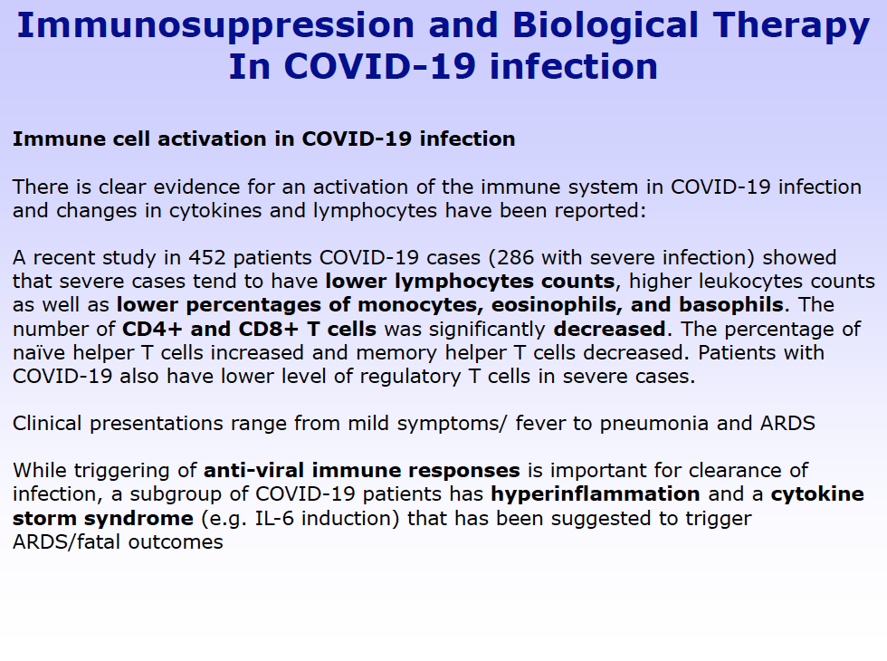

Slide 21
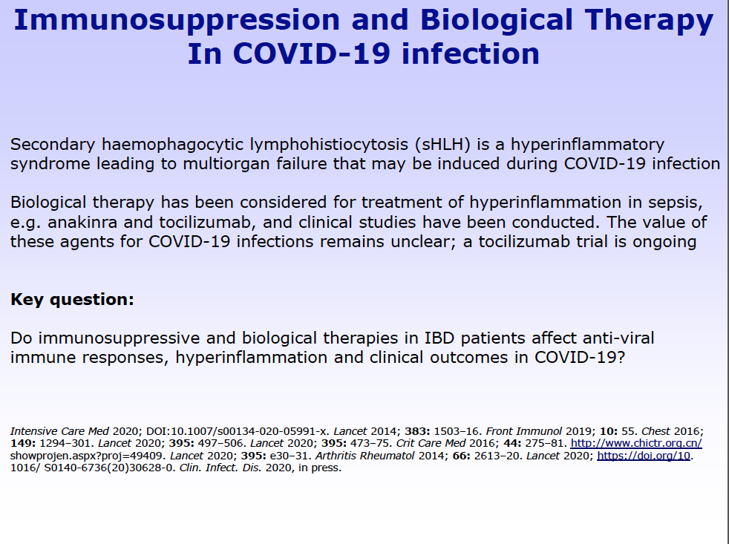

Slide 22
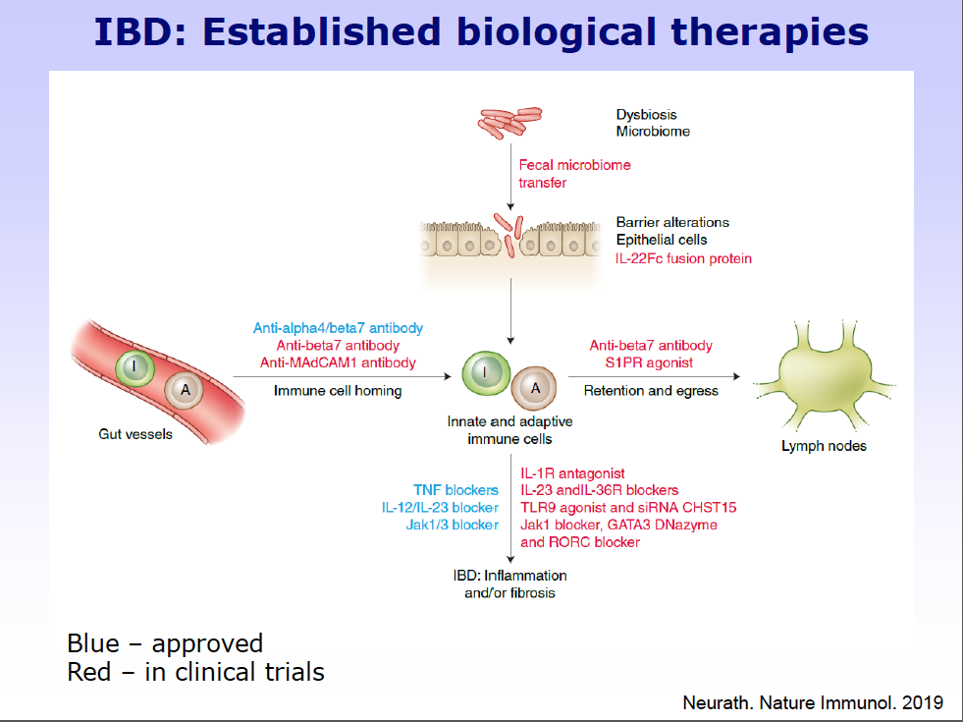

Slide 23
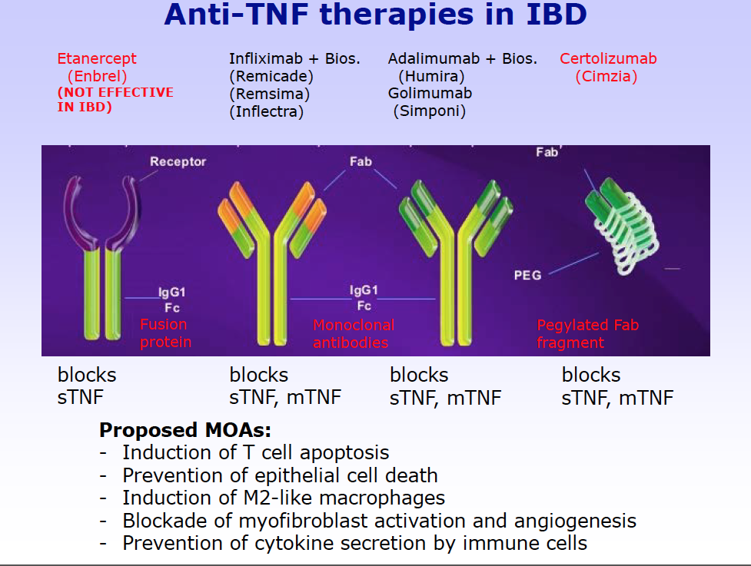

Slide 24
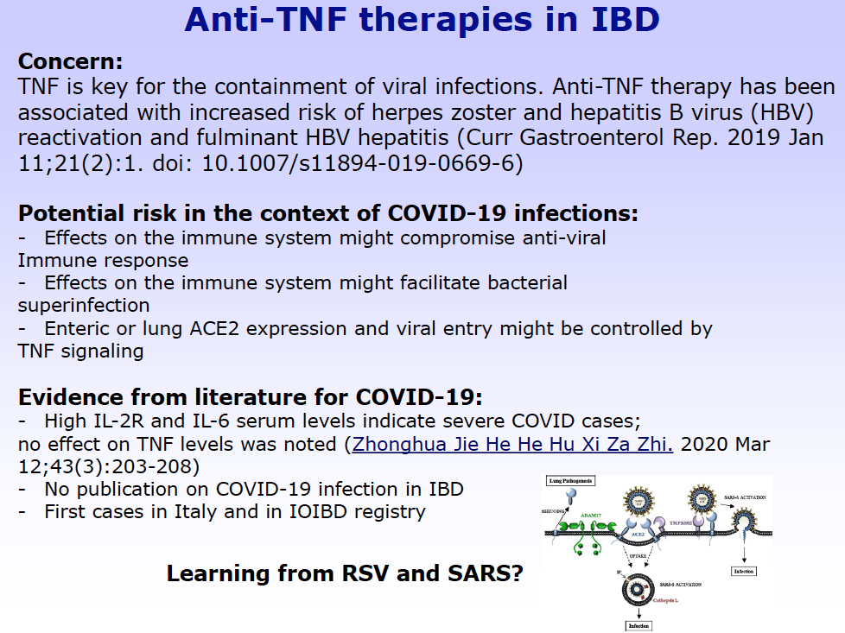

Slide 25
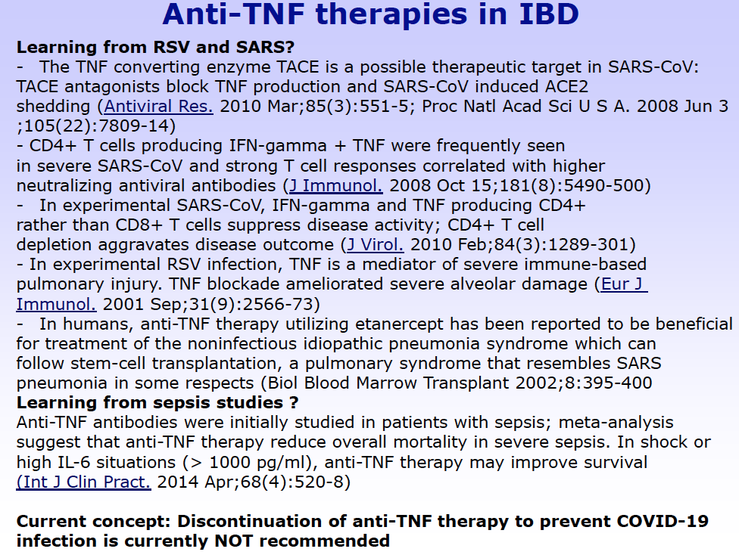

Slide 26
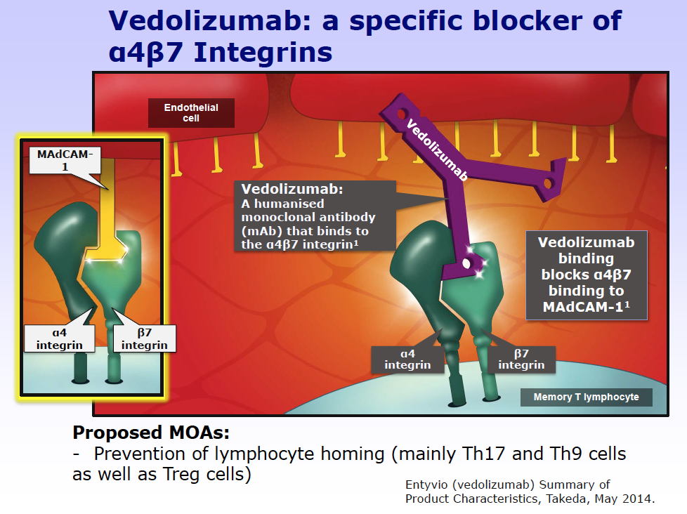

Slide 27
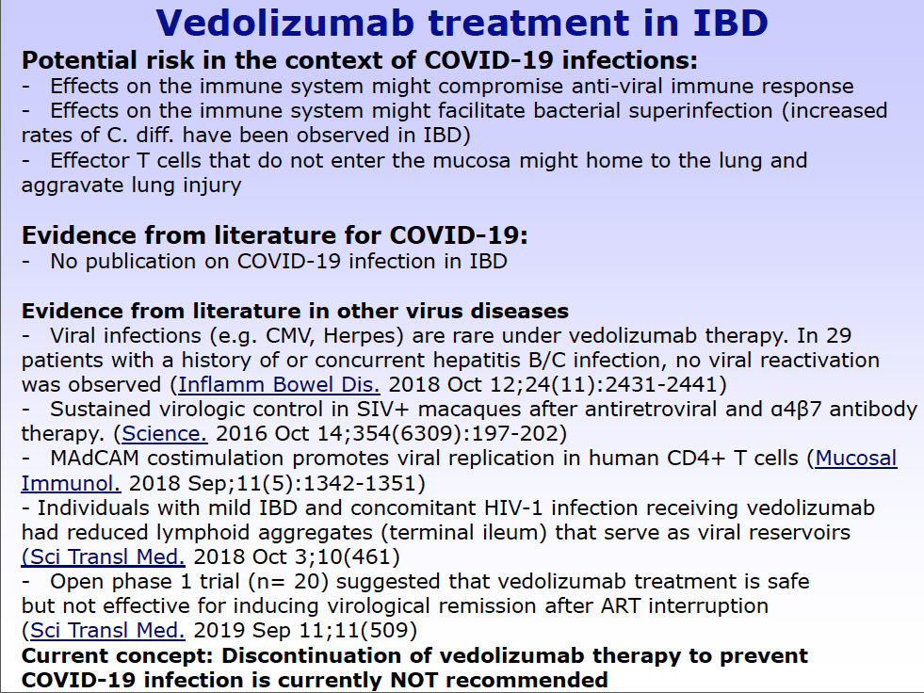

Slide 28
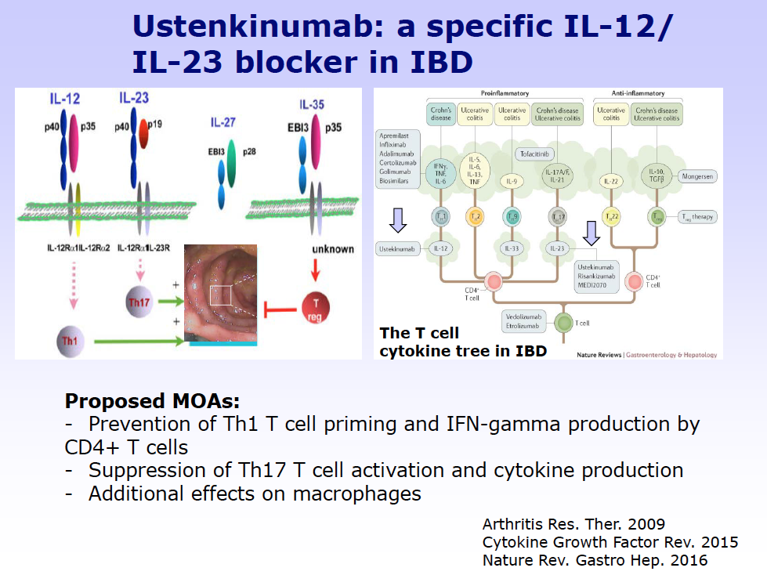

Slide 29
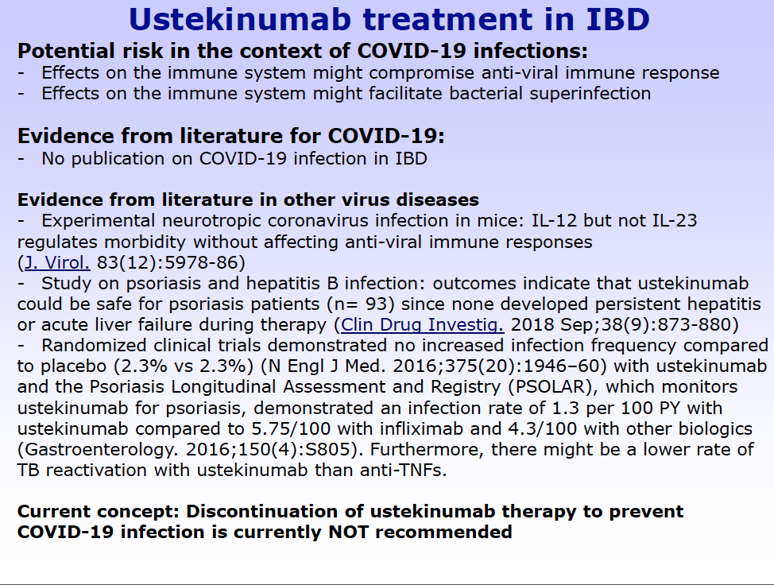

Slide 30
Summary of Therapies
Statement | 5-ASA | Bud | Pred | AZA/ 6MP | MTX | Anti-TNF | VEDO | UST | TOFA
Increases the risk of infection with SARS-CoV-2.
Increases the risk of COVID-19 disease.
Patients taking this should reduce the dose of therapy to prevent SARS-CoV-2 infection.
Patients taking this should discontinue therapy to prevent SARS-CoV-2 infection.
Patients taking this should stop therapy if they test positive for SARS-CoV-2 but don’t have the COVID-19 disease.
Patients taking this should stop therapy if they develop COVID-19.

Slide 31
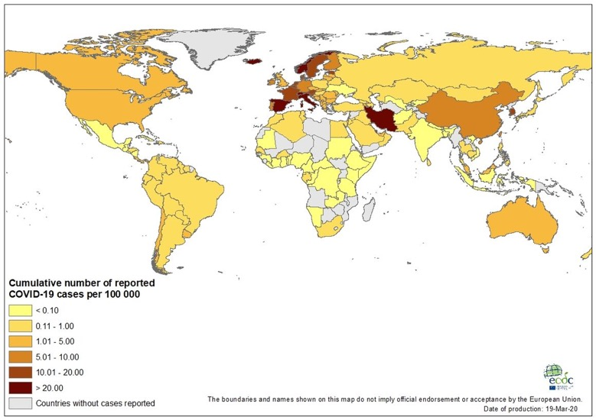
Updates from our colleagues
Siew Ng – Hong Kong
Zhihua Ran – China
Silvio Danese – Italy

Slide 32

Michael Kappelman MD, MPH (University of North Carolina at Chapel Hill)
Erica Brenner, MD (University of North Carolina at Chapel Hill)
Ryan Ungaro, MD (Icahn School of Medicine at Mount Sinai, New York)

Slide 33


Not exactly Bordeaux. . .
Originally invited to speak at the IOIBD Real World Evidence program this week
Honored to be speaking to this esteemed group today about the SECURE-IBD COVID-19 reporting project

Slide 34
Purpose
To rapidly define the impact of COVID-19 on patients with IBD, including the impact of factors such as age, comorbidities, and IBD treatments on COVID outcomes.
To provide regular updates (at least weekly) to the IBD community regarding number of reported cases and outcomes, including data broken down by geographic region and IBD treatment.

Slide 35
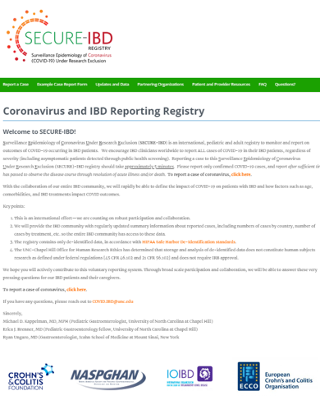
3 Components
Registry
Website
Communication and dissemination strategy

Slide 36
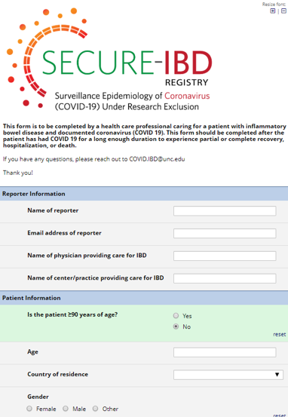
Registry
Built using REDCap
Collects data on patient location, demographics, IBD characteristics, comorbidities, and COVID-19 outcomes
Completion time < 5 minutes
All data are de-identified, in accordance with HIPAA Safe Harbor standards.
The UNC-Chapel Hill Office for Human Research Ethics has determined that the Registry does not constitute human subjects research as defined under U.S. regulations [45 CFR 46.102 and 21 CFR 56.102]

Slide 37
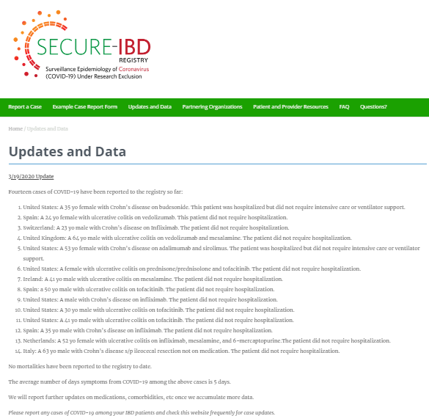
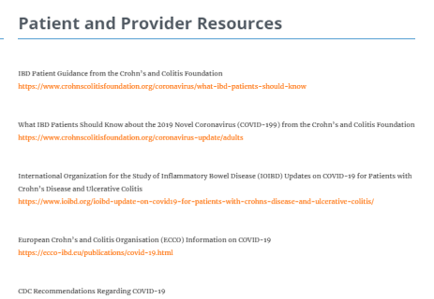
Website
Landing page
Project information and FAQs
Access to the registry
Facilitate rapid sharing of data
Link to patient/provider resources
Acknowledge partnering organizations

Slide 38
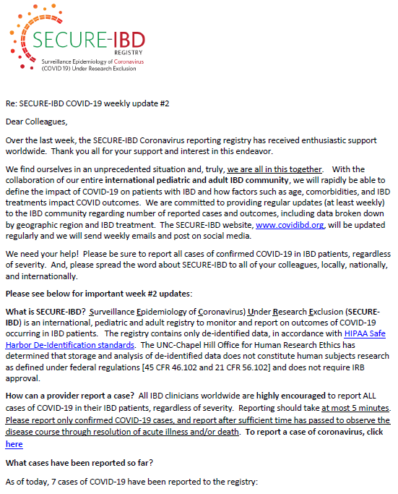
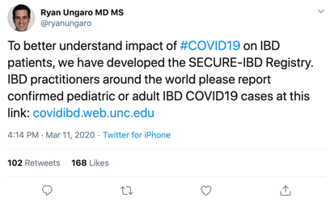
Communications and dissemination
Engage and excite international pediatric and adult IBD communities
Encourage broad participation
Theme: “We are all in this together”
Transparency and data sharing
Social media!

Slide 39
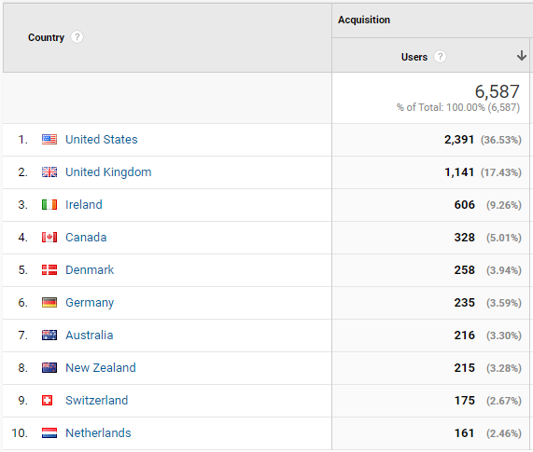
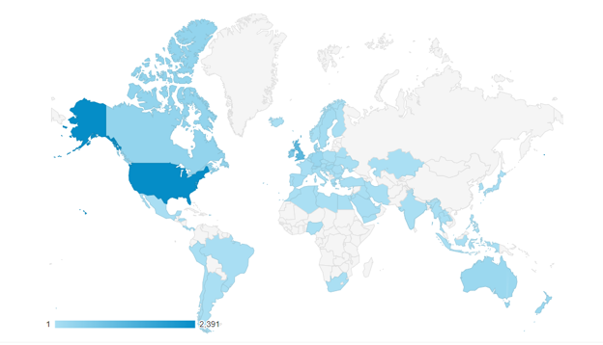
Reach and impact

Slide 40

A blueprint for other conditions
Reached out to/approached by other disease groups
  cirrhosis and liver transplants
  celiac disease
  psoriasis, juvenile idiopathic arthritis
  rheumatoid arthritis
  Lupus
  sickle cell
  hematological malignancies (i.e. leukemia and multiple myeloma)

Slide 41

We need your help
To spread the word!!!
Share our weekly updates with your colleagues
Forward to listservs/groups you are part of
Social media
Any other contacts/connections you have

Slide 42

Our Partners (working on others)

Slide 43
What we’ve learned so far. . .
Through 3/19/20 we have 15 reported cases logged
Europe: 9
Asia: 0
North America: 6
Australia: 0
North American Cases
USA: 6
European Cases
Spain: 3
Switzerland 2
UK 1
Ireland 1
Netherlands 1
Italy 1
Africa: 0
South America: 0

Slide 44
Overview of Reported Cases To Date
  Median age 41 (range 23-64)
  Men: 10/15 (67%)
  White: 14/15 (93%)
  6 Crohn’s disease (40%) and 9 ulcerative colitis (60%)
  IBD disease activity at time of infection (by PGA)
    Remission 9 (60%)
    Mild 4 (27%)
    Moderate 2 (13%)

Slide 45
Overview of Reported Cases To Date
  Comorbidities
    Cardiovascular disease: 1
    Diabetes: 0
    Asthma: 1
    Hypertension: 3
    Cancer: 0
    Chronic kidney disease: 0
    Chronic liver disease: 0
  Current cigarette smoking: 0

Slide 46
Medications
One patient with chronic liver disease (likely OLT) also on sirolimus (with anti-TNF)

Slide 47
Type of Biologic

Slide 48
Overview of Reported Cases To Date
  Patients who reported new/worsening GI symptoms: 4 / 15 (27%)
    Diarrhea 4/4 (100%), 1 each of nausea, vomiting, abdominal pain
  Medications stopped due to COVID-19: only 2 medications stopped
    ADA: 1
    Tofacitinib: 1
  Outcomes
    Seen in Emergency Department: 5 / 15 (33%)
    Hospitalized: 2 / 15 (13%)
    ICU or Step-Down: 0
    Required Ventilator: 0
    Deaths: 0
Potential Caveat?
Days symptomatic from COVID-19:
Median 5 (range 2-14)
Symptoms fully resolved at time of reporting: 5 (33%)
May need to add minimum # days since diagnosis to avoid missing cases that later worsen

Slide 49
Other Cases on News, Social Media, or Known Pending
Austria Case: Fatality
  Per Siew Ng communication with Dr. Herbert Tilg: 69-year old male with many co-morbidities (including type 2 Diabetes) and ulcerative colitis, but only treated with mesalazine, no biologics or azathioprine
Italy: at least 5 mentioned on Twitter
Spain: 1 case on Twitter
Mount Sinai Hospital in NYC: 9 cases pending more info on disease course (none to my knowledge hospitalized)

Slide 50
Thank you for your support and input on this initiative!
Questions, comments, suggestions?

